Slide 1
Spring AOP framework
Loc Bui

Slide 2
Spring aop framework – loc bui
Introduction
Spring Framework?
Constituent of String Framework
Spring AOP Framework
AOP concepts, types of advice
Demo
Do some examples using AOP
Advantages and disadvantages of AOP

Slide 3
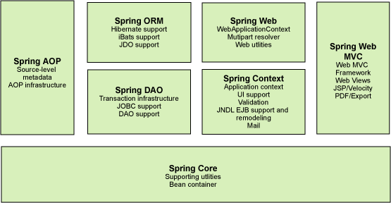
Spring framework
Spring is the most popular application development framework for enterprise Java
Spring framework is an open source Java platform
Spring is lightweight when it comes to size and transparency
The core features of the Spring Framework can be used in developing any Java application

Slide 4
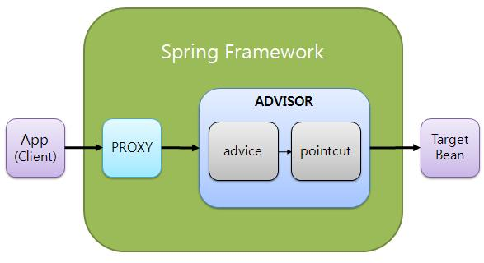
Spring AOP
Spring AOP (Aspect-oriented programming) framework is used to modularize cross-cutting concerns in aspects. Put it simple, it’s just an interceptor to intercept some processes. Spring AOP can hijack the executing method, and add extra functionality before or after the method execution.
It’s used to manage logging, transaction, data access, security, …
Another important term in AOP is advice. It is the action taken by an aspect at a particular join point. There are five types of advice in spring AOP.

Slide 5
Spring AOP
Aspect
Join point
Advice
Introduction
Target object
Weaving
Pointcut
A actual place in the application where an action will be taken using Spring AOP framework
This is a module which has a set of APIs providing cross-cutting requirements. An application can have any number of aspects depending on the requirement
A set of one or more join points where an advice should be executed
This is the actual action to be taken either before or after the method execution
An introduction allows you to add new methods or attributes to the existing classes.
Weaving is the process of linking aspects with other application types or objects to create an advised object
The object being advised by one or more aspects. This object will always be a proxied object, also referred to as the advised object.

Slide 6
Types of Advice
Before
Run advice before the a method execution
Around
Run advice before and after the advised method is invoked
After
After - returning
Run advice after the method execution, regardless of its outcome
After - throwing
Run advice after the a method execution only if method completes successfully.
Run advice after the a method execution only if method exits by throwing an exception.

Slide 7
Advantages of spring AOP
It uses Spring’s IOC container for dependency injection, Aspects can be configured as normal spring beans.
Makes it easier to configure, understand and manage
The AOP interceptor is used by all methods in the DAOs
Makes change, re-use and testing simple

Slide 8
Disadvantages of AOP
A little difficult to debug the AOP based application code.
Only method - level advising is supported, doesn’t support field - level interception
Only methods with public visibility will be advised. Local or internal method calls within an advised class doesn’t get intercepted by proxy

Slide 9
Spring aop framework
Thank you !

